Slide 1
Using CSP to Detect Errors in the TMN Protocol
Gavin Lowe and Bill Roscoe

Slide 2
Overview
The TMN Protocol
Modeling the Protocol in CSP
Attacks upon the Protocol
The second Protocol and Attacks upon it
The third Protocol and its Authentication
Testing for Authentication
Conclusions

Slide 3




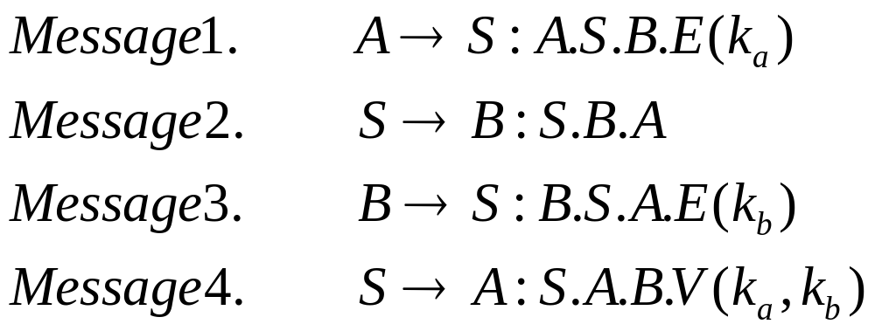
The TMN Protocol
a key distribution protocol
Initiator
(A)
Server
Responder(B)

Slide 4
Sets and Channels
Sets
  Initiator Responder Key
Channels
  channel comm, fake, intercept : MSG
  channel user : Initiator. Responder
  channel session, init_fake_session, resp_fake_session, leak_session : Initiator.Responder.Key

Slide 5
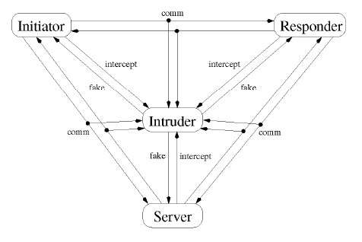
Modeling the Protocol in CSP(1)

Slide 6
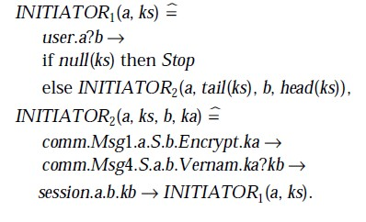
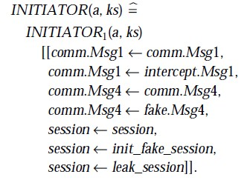

Modeling the Protocol in CSP(2)
Initiator
(without intruder actions) (add intruder actions)
Responder and Server similarly.

Slide 7
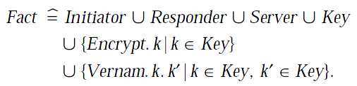

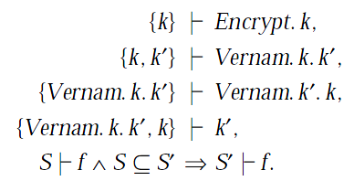
Modeling the Protocol in CSP(3)
Intruder
(set of facts that the intruder might learn)
(inference rules)

Slide 8
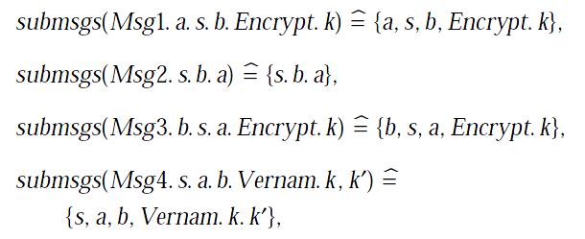
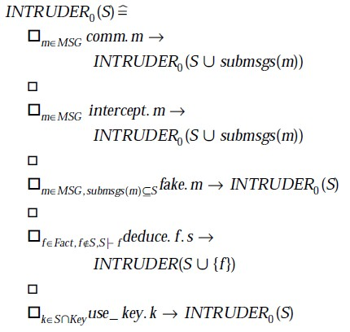
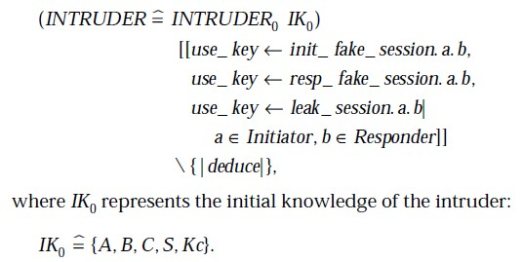
Modeling the Protocol in CSP(4)
(facts that an intruder will
learn by seeing a message)

Slide 9
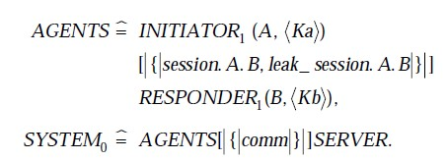
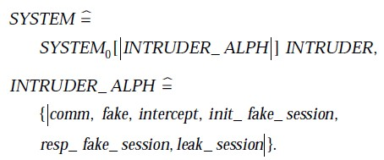
Modeling the Protocol in CSP(5)
System
(without the intruder)
(add the intruder)

Slide 10
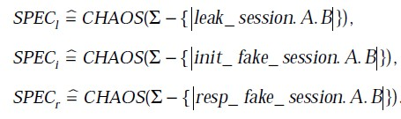
Modeling the Protocol in CSP(6)
Spec
If the system with the intruder refined these specifications, then it would indeed be secure.

Slide 11



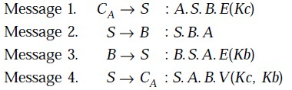
Attacks upon the Protocol
Attack 4.1 System does not refine .
Intruder
(C)
Server
Responder(B)

Slide 12


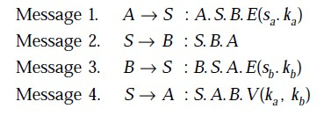
The second Protocol
A weakness in TMN protocol is that the server has no way of authenticating the origins of Messages 1 and 3. So each initiator and responder should share a secret with the server.
Initiator
(A)
Server
Responder(B)

Slide 13







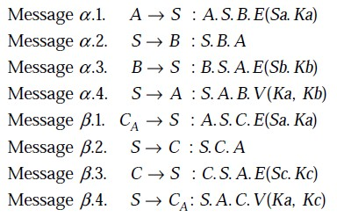
Attacks upon the second Protocol
Attack 5.4 System does not refine .
Initiator
(A)
Server
Responder(B)
Intruder
(C)
Server
Responder(C)
overheard by C
intercepted by C

Slide 14


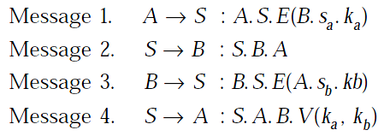
The third Protocol
The reason these attacks succeed is that the intruder is able to alter the meaning of legitimate instances of Message 1 and Message 3.So the encrypted part should include the identity of the other agent involved in the protocol run.
Initiator
(A)
Server
Responder(B)

Slide 15

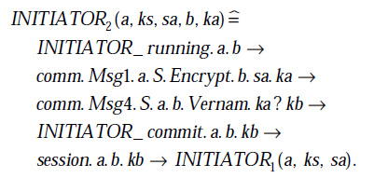
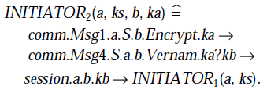
Testing for Authentication(1)
The resulting system refines each of , and when A and B can each run the protocol at most twice.
We now test whether the third protocol authenticates the two agents to one another; in other words, if an agent completes a run of the protocol, can he be sure that the other agent really is present?
Initiator
Responder similarly.

Slide 16
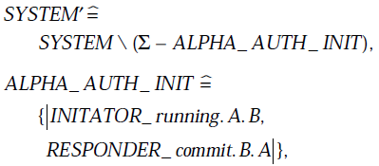

Testing for Authentication(2)
Test whether the initiator is correctly authenticated.
Abstraction of system
Spec
We must test whether this process refines this specification.

Slide 17

Testing for Authentication(3)
Attack 7.1 The initiator can’t be authenticated.
Similarly, the responder can’t be authenticated too.
Server
(C)
Responder(B)

Slide 18
Conclusions
Some of the attacks discovered are known, but most are new, so the number and variety of attacks demonstrate that using the process algebra CSP and its model checker FDR is a very successful way of automatically detecting errors in security protocols.

Slide 19
Thank you!

